Slide 1




Forecasting UK population growth rate using Hidden Markov Model based on theory of the Second Demographic Transition
Author
&Presenter: Yuanhe Zhang Supervisor: Dr Krzysztof Łatuszyński
Jialong Xu
Wen Jiang

Slide 2
The structure of this presentation
Question： The impact of SDT factors on the UK’s population
1
2
3
The Research Method
Background: What is the SDT transformation
4
Statistic Support
Fit to our problem
5
6
Conclusion and Application

Slide 3
Background: What is the SDT transformation
“Behind the 2nd transition is a dramatic shift in norms toward progressiveness and individualism, which is moving Europeans away from marriage and parenthood” (Van de kaa 1987).
Characteristics of the 2nd demographic transition includes “sustained sub-replacement fertility, a multitude of living arrangements other than marriage, the disconnection between marriage and procreation, and no stationary population” (Lesthaeghe and Surkyn 2008, pp.82; Lesthaeghe 2010, pp. 211; Lesthaeghe 2014, pp 18112).

Slide 4
Question: The impact of SDT factor on the UK’s population
The development of contraceptive technology
The collapse of traditional families
Second Demographic Transaction
Reform of female social norms

Slide 5

Question: The impact of SDT factor on the UK’s population
Can we use the quantitative method to prove whether this theory is valid in Britain?
First Fertility Rate
Fertility Rate
Divorce Rate

Slide 6


Research Method
Rule: toss one coin and guess head or tail

Slide 7

Research Method
Simple case: Head or Tail
We assume, for some strange reasons, in this game more people bet on tails than heads. The boss of casino is a crooked dealer. He might use a biased coin that turns out to be more heads than tails. We will assume that this biased coin produces heads with probability 3/4.

Slide 8
Research Method
Simple case: Head or Tail
the crooked dealer is wearing a shirt and keeps both coins up his sleeve, secretly changing them back and forth whenever he likes during the sequence of flips. Since he does not want to be caught switching coins, he does so only occasionally (with prob 9/10).

Slide 9

The crooked dealer tossed the coin for 5 times so we got an ordered known outcome sequence.
i.e. (head,head,tail,head,tail)
The crooked dealer tossed the coin for 5 times so we got an ordered known outcome sequence i.e. (head,head,tail,head,tail)
i.e. (biased,unbiased,unbiased,biased,biased)

Slide 10

Research Method
In this Problem
What we can observe is the outcome sequence of dice. And we called (head,tail) as observation states.
What we cannot observe is the probable combination of dice used by the crooked dealer. And we called (biased,unbiased) as hidden states.

Slide 11




Research Method
Structural architecture: Markov Chain
Head
$$\frac{1}{2}$$
$$\frac{3}{4}$$
$$\frac{9}{10}$$
Unbiased
$$\frac{1}{10}$$
$$\frac{1}{10}$$
Biased
$$\frac{9}{10}$$
$$\frac{1}{2}$$
Tail
$$\frac{1}{4}$$

Slide 12

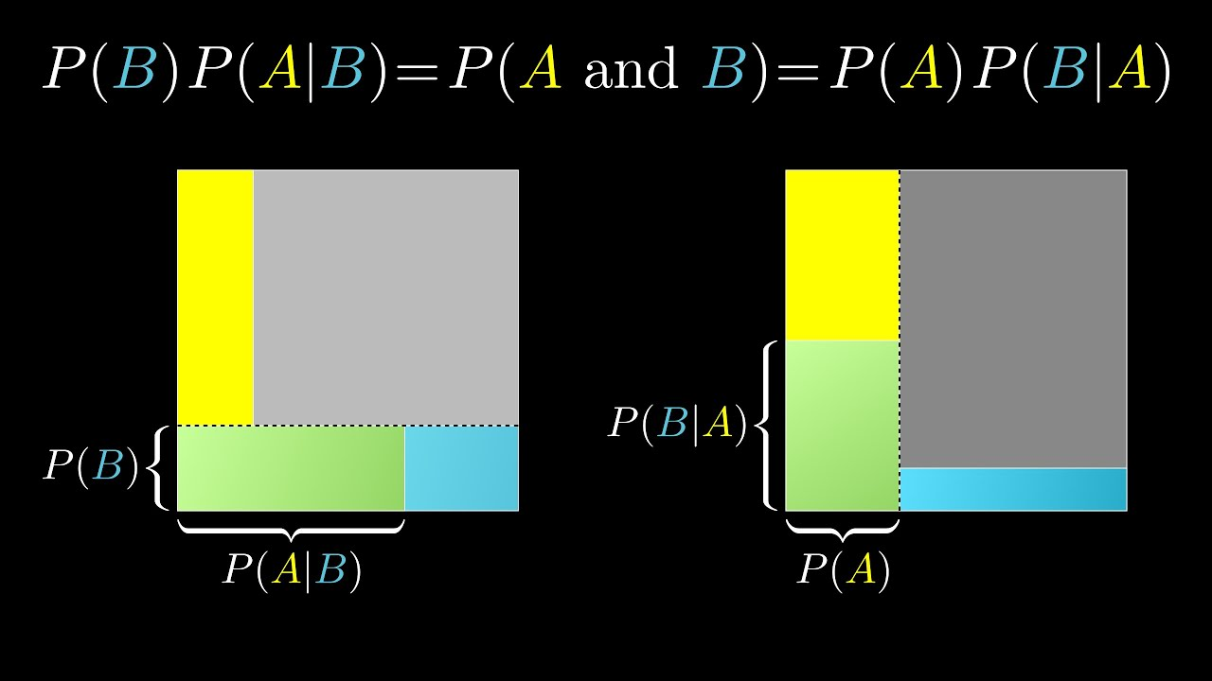
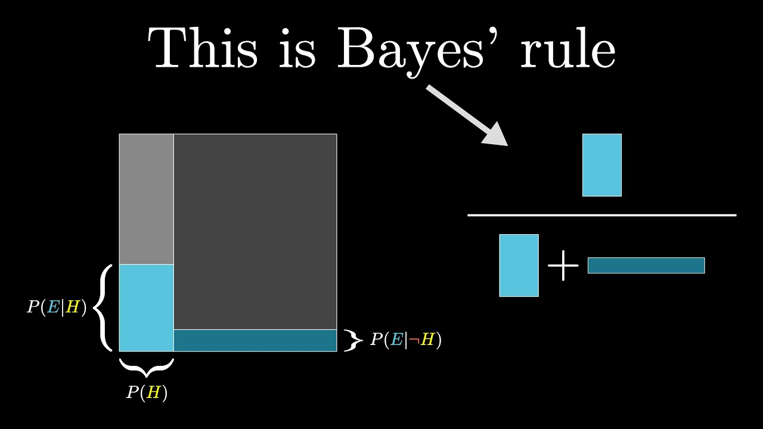

Statistic Support
Baye’s Rules
$$P\left(A | B\right)=\frac{P(B|A)P(A)}{P(B)}$$

Slide 13
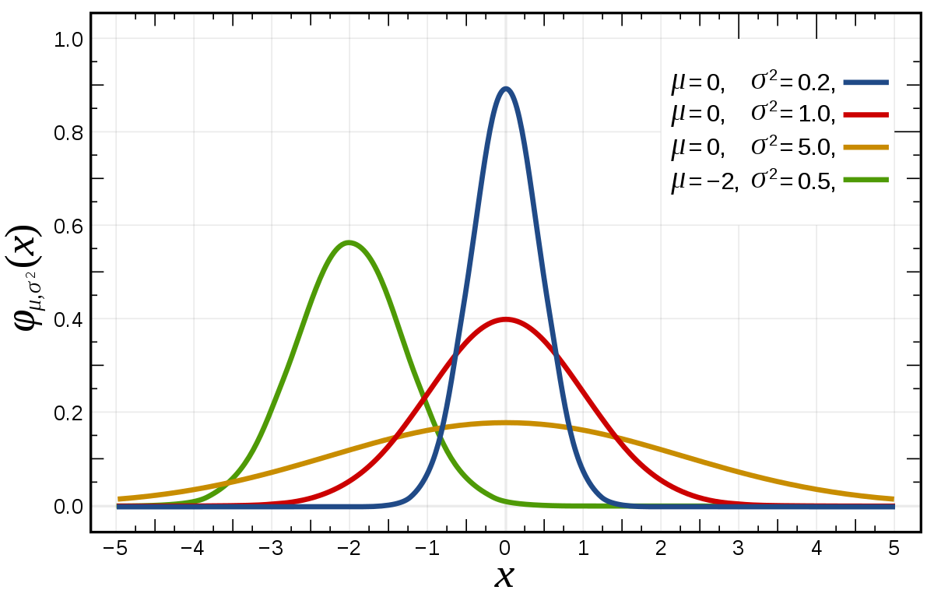

Statistic Support
Gaussian Distribution
$$f\left(x\right)=\frac{1}{σ\sqrt{2π}}e^{−\frac{1}{2}{\left(\frac{x−μ}{σ}\right)}^{2}}$$
$$x=value of the variable or data being examined and f\left(x\right) is the probability function$$
$$μ=mean value$$
$$σ=the standard deviation$$

Slide 14
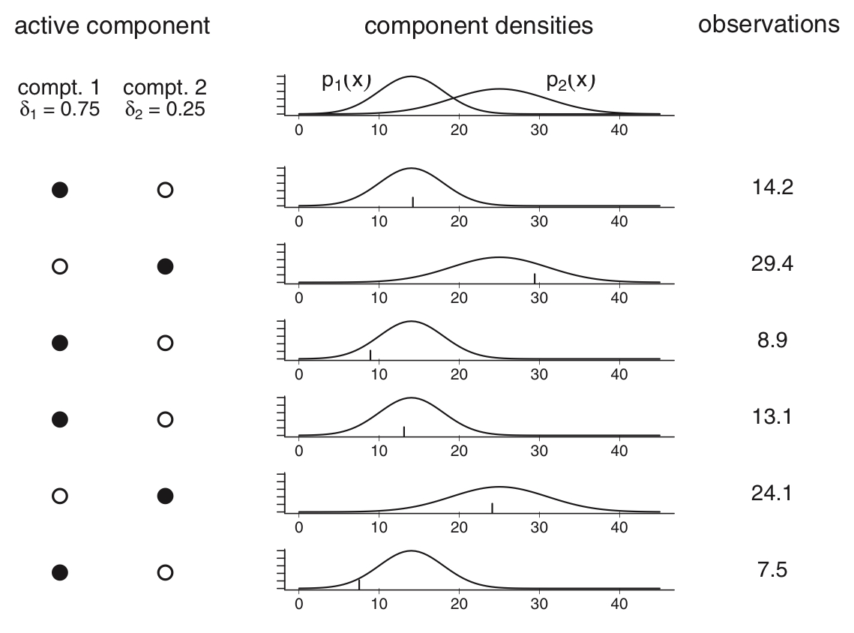
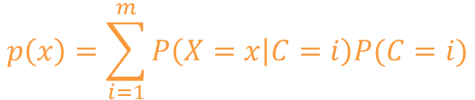
Statistic Support
Mixture Distribution
$$p\left(x\right)=\sum_{i=1}^{m}{P\left(X=x | C=i\right)P(C=i)}$$

Slide 15
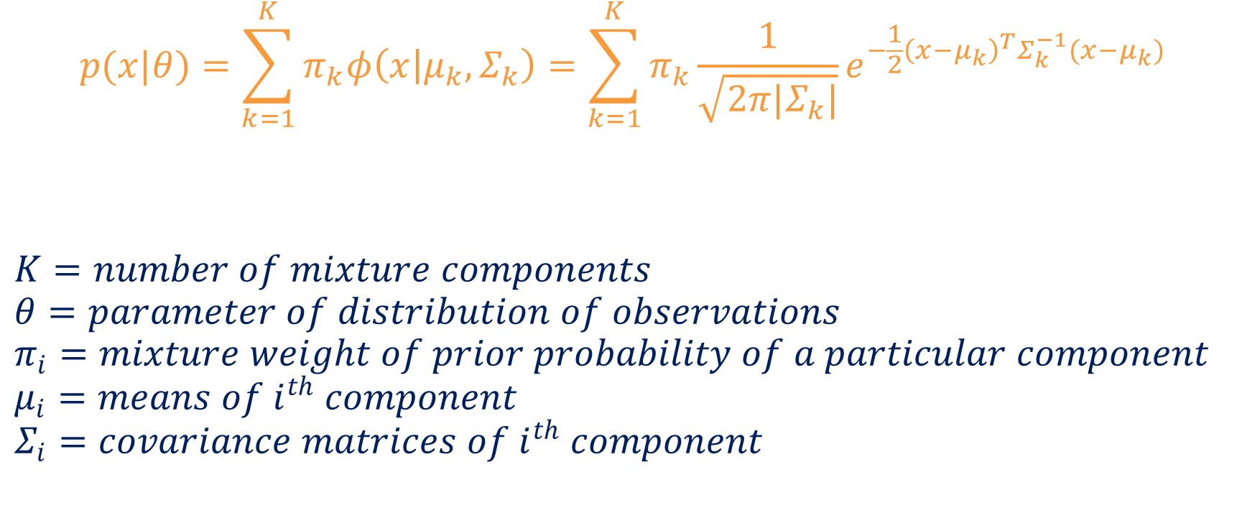
Statistic Support
Gaussian Mixture Model (GMM)
$$p(x|θ)=\sum_{k=1}^{K}{π_{k}φ\left(\left.x\right|μ_{k},Σ_{k}\right)}=\sum_{k=1}^{K}{π_{k}}\frac{1}{\sqrt{2π|Σ_{k}|}}e^{−\frac{1}{2}{\left(x−μ_{k}\right)}^{T}Σ_{k}^{−1}(x−μ_{k})}$$
$$K=number of mixture components$$
$$θ=parameter of distribution of observations$$
$$π_{i}=mixture weight of prior probability of a particular component$$
$$μ_{i}=means of i^{th} component$$
$$Σ_{i}=covariance matrices of i^{th} component$$

Slide 16
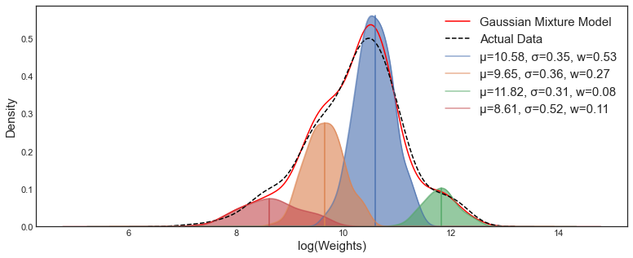
Statistic Support
Gaussian Mixture Model (GMM)

Slide 17

Fit to Our Problem
The interpretation of the result under SDT framework
When the distribution of observation sequences is continuous, HMM can be established with parameters. The observation sequence in each hidden state refers to a Gaussian mixture distribution.
In the view of the SDT framework, the population growth process can be seen as a hidden Markov process, we can see the changes in the fertility rate, divorce rate and age at first fertility, while the hidden state behind the population growth rate (up, down , or unchanged) is unknown.

Slide 18
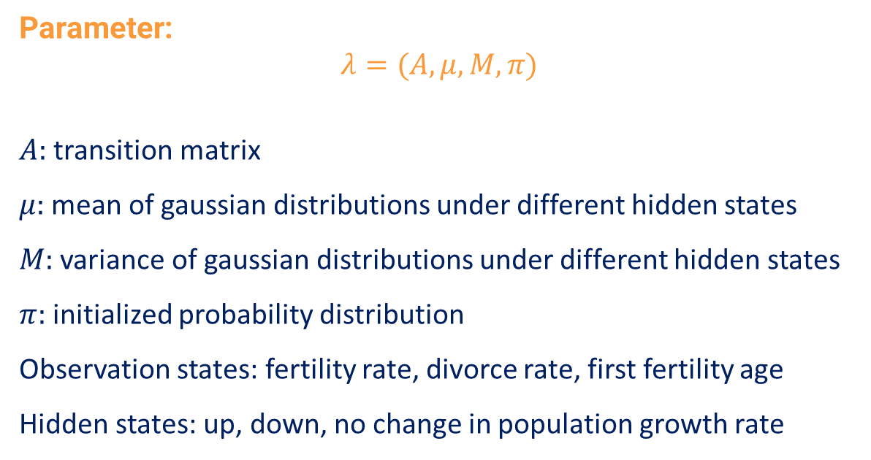
Fit to Our Problem
Modelling the HMM-GMM (Strategy Overview)
Parameter:
$$λ=(A,μ,M,π)$$
$A:$ transition matrix
$μ:$ mean of gaussian distributions under different hidden states
$M:$ variance of gaussian distributions under different hidden states
$π:$ initialized probability distribution
Observation states: fertility rate, divorce rate, first fertility age
Hidden states: up, down, no change in population growth rate

Slide 19
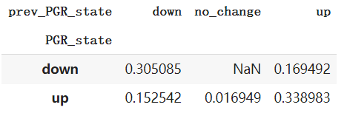
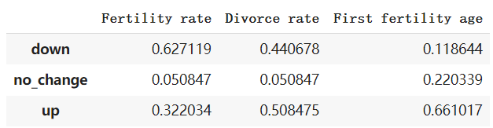
Fit to Our Problem
Modelling the HMM-GMM (Strategy Overview)
Transition matrix
Emission matrix

Slide 20
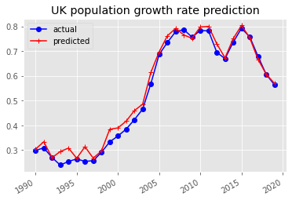
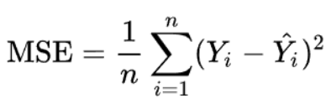
Fit to Our Problem
Testing
Testing metric: mean square error (MSE)
0.00086601093

Slide 21
Conslusion and Application

Slide 22



Conslusion and Application
Predict future population
A reference to other similiar researches

Slide 23
Reference List
Baum L, et al. A maximization technique occuring in the statistical analysis of probabilistic functions of Markov chains. Annals of Mathematical Statistics, 1970, 41: 164–171.
Bilmes JA. A gentle tutorial of the EM algorithm and its application to parameter estimation for Gaussian mixture and hidden Markov models. http://ssli.ee.washington.edu/~bilmes/mypubs/bilmes1997-em.pdf.
Ghahramani Z. Learning Dynamic Bayesian Networks. Lecture Notes in Computer Science,Vol. 1387, 1997, 168–197.
Gupta, Aditya, and Bhuwan Dhingra. "Stock market prediction using hidden markov models." 2012 Students Conference on Engineering and Systems. IEEE, 2012.
Hang Li. Statistical Learning Methods. Qing hua da xue chu ban she, 2012. (pp. 171-186).
Lesthaeghe R, Surkyn J. When history moves on: The foundations and diffusion of a second demographic transition. Ideational perspectives on international family change. 2008:81–118.
Lesthaeghe R. The Unfolding Story of the Second Demographic Transition. Population and Development Review. 2010;36:211–51.
Lesthaeghe R. The second demographic transition: A concise overview of its development. Proceedings of the National Academy of Sciences. 2014 201420441.
Lari K, Young SJ. Applications of stochastic context-free grammars using the Inside-Outside algorithm, Computer Speech & Language, 1991, 5(3): 237–257.
Nguyen, N., & Nguyen, D. (2015). Hidden Markov model for stock selection. Risks, 3(4), 455–473.
Nguyen, N. (2017). An analysis and implementation of the hidden Markov model to technology stock prediction. Risks, 5(4), 62.

Slide 24
Reference List
Nguyen, Nguyet. "Hidden Markov model for stock trading." International Journal of Financial Studies 6.2 (2018): 36.
Rabiner L, Juang B. An introduction to hidden markov Models. IEEE ASSP Magazine, January 1986.
Rabiner L. A tutorial on hidden Markov models and selected applications in speech recognition. Proceedings of IEEE, 1989.
Stochastic differential equations. In Stochastic differential equations, Øksendal, B. (2003), Springer, Berlin, Heidelberg. (pp. 65–84).
Scikit-learn: Machine Learning in Python, Pedregosa et al., JMLR 12, pp. 2825–2830, 2011 http://www.blackarbs.com/blog/introduction-hidden-markov-models-python-networkx-sklearn/2/9/2017
van de Kaa DJ. Europe’s second demographic transition. Washington, D.C: Population Reference Bureau; 1987.

